Slide 1
Group-7’s
GROUP ALLOCATION SYSTEM
Zeynep Nur AKSAY

Slide 2
What is an algorithm?
An algorithm is a set of rules to follow in order to solve a problem.

Slide 3
What is Group Allocation System?
It is an algorithm-based web application that allocates students to groups depending on their preferences in a short time.

Slide 4
Blackboard’s
Group Allocation System

Slide 5
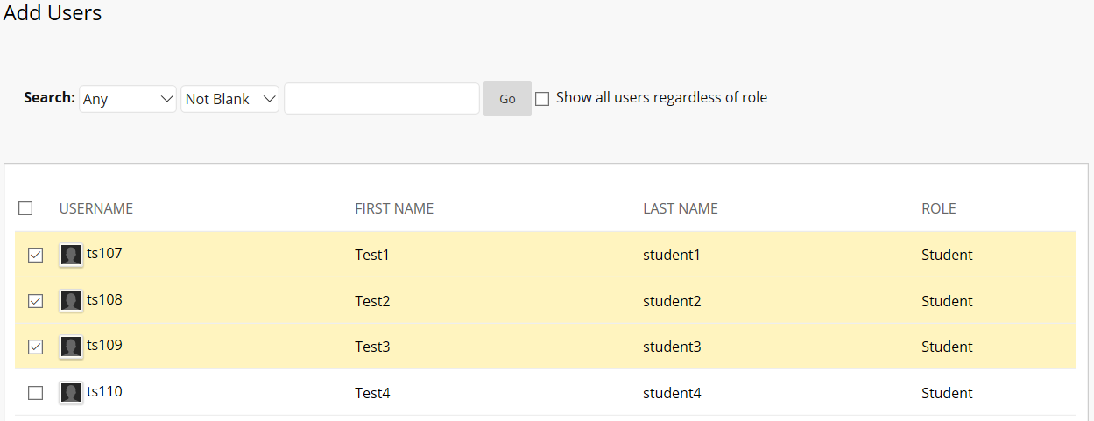
Collect data from different forms
Create groups
Assign students manually

Slide 6
How does our system work?

Slide 7
Two roles:
-Convenor -> creates question sets
-Student -> answers questions

Slide 8
Allocation opportunities:
- Based on preferences
- Random
- Based on group member names

Slide 9
…and
all groups are ready in around
200ms :)

Slide 10
Question Sets
Cameron Ward

Slide 11
Purpose
Save time
Fix mistakes
Organise questions
View as a student

Slide 12
Features Overview
Template Question Types
Edit questions
Weight questions on importance
Group answers by similar or different responses

Slide 13

Step 1

Slide 14
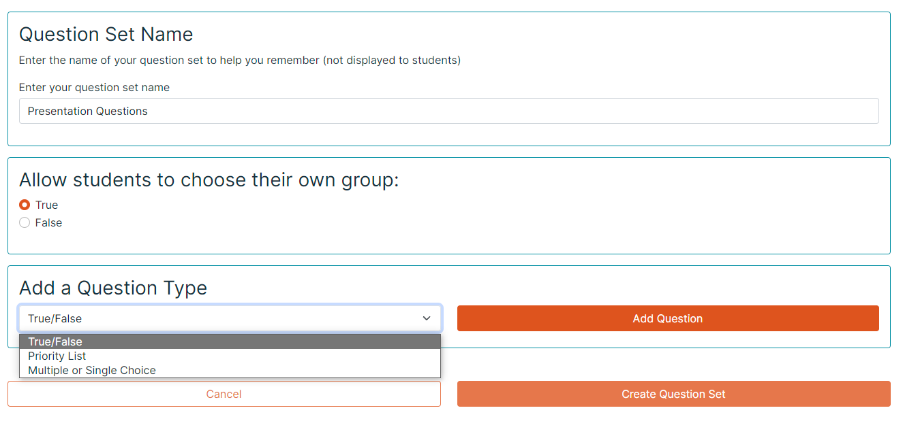
Step 2

Slide 15
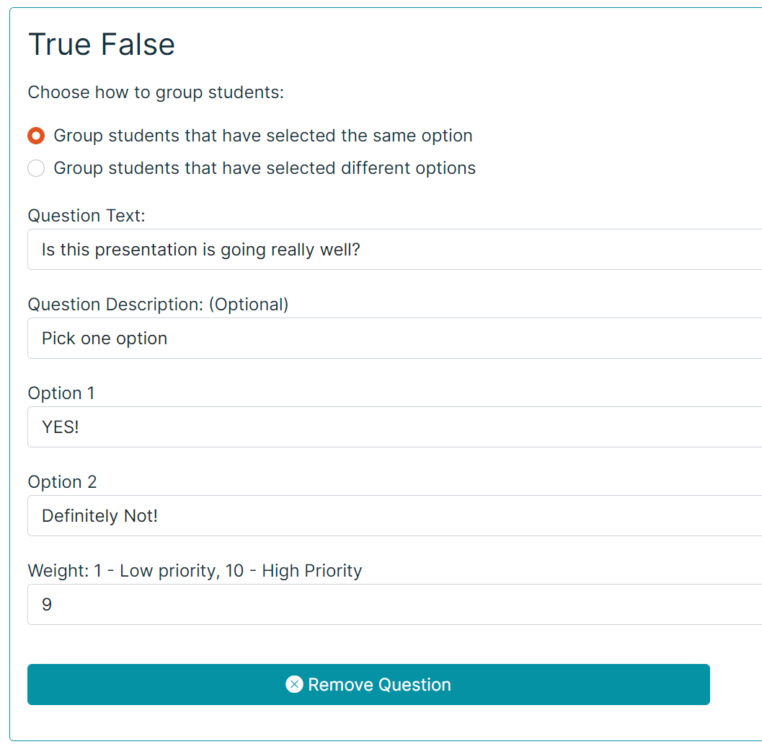
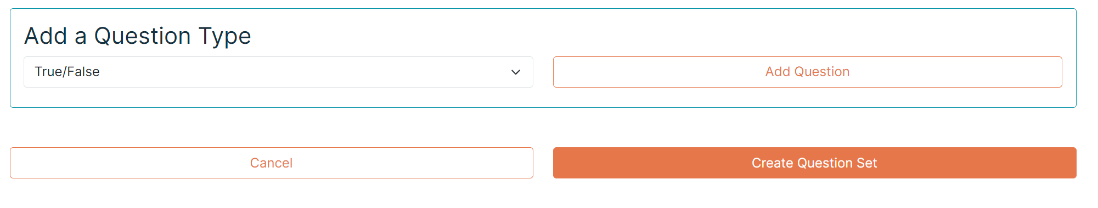
Step 3

Slide 16
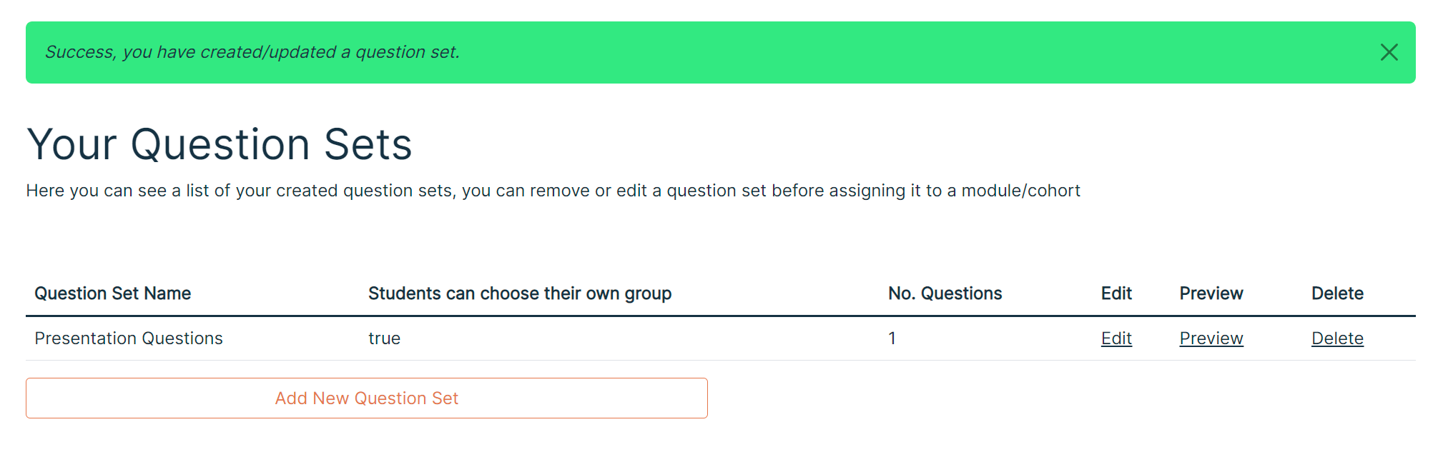
Step 4

Slide 17
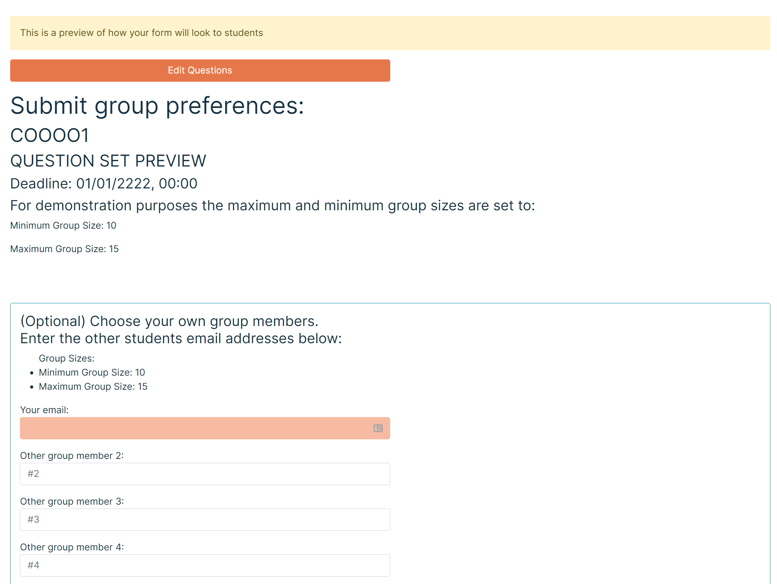
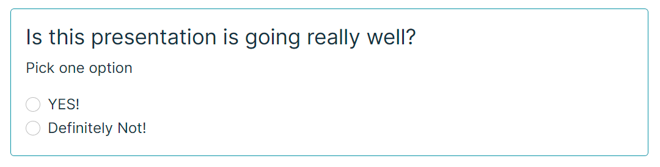
Student Preview

Slide 18
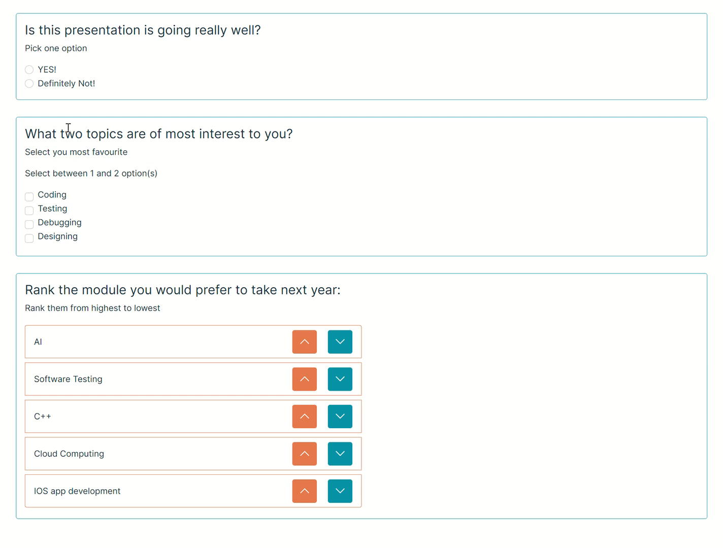
Other Question Formats

Slide 19

Any Questions?

Slide 20
The group allocation algorithm

Slide 21
Information about the algorithm
KNN (K-Nearest Neighbour) algorithm
Used a form of supervised learning
Our system allows the convenor to determine how the students’ data will be used to allocate other students
Has a system to ensure all students have the best matching group

Slide 22
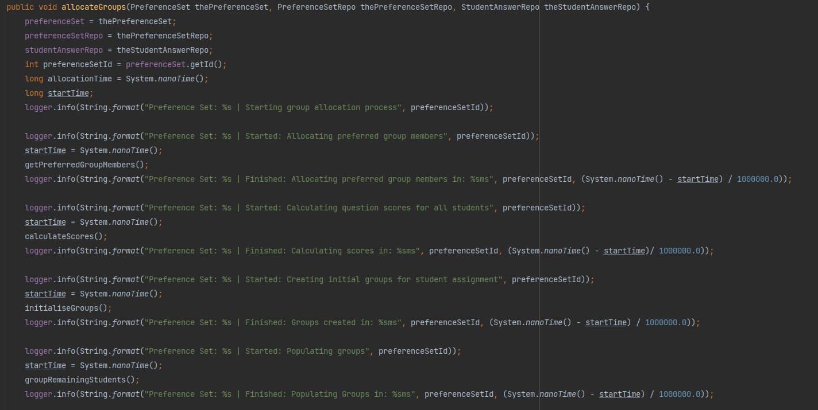
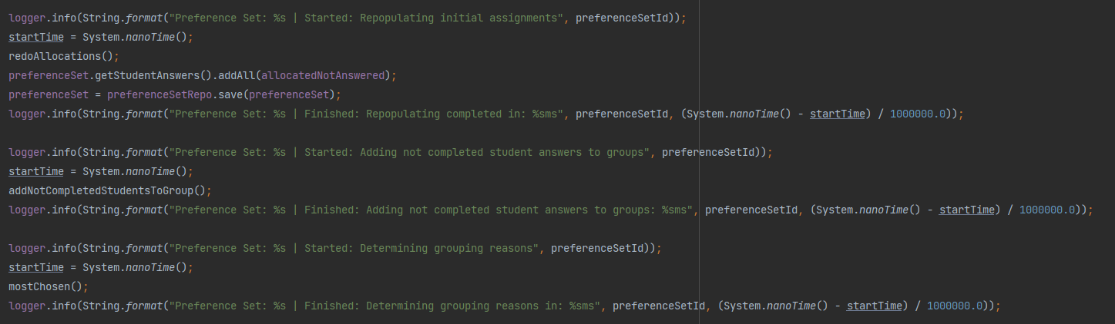
Explanation of the algorithm
getPreferredGroupMembers();
calculateScores();
initialiseGroups();
groupRemainingStudents();
redoAllocations();
addNotCompletedStudentsToGroup();
mostChosen();

Slide 23
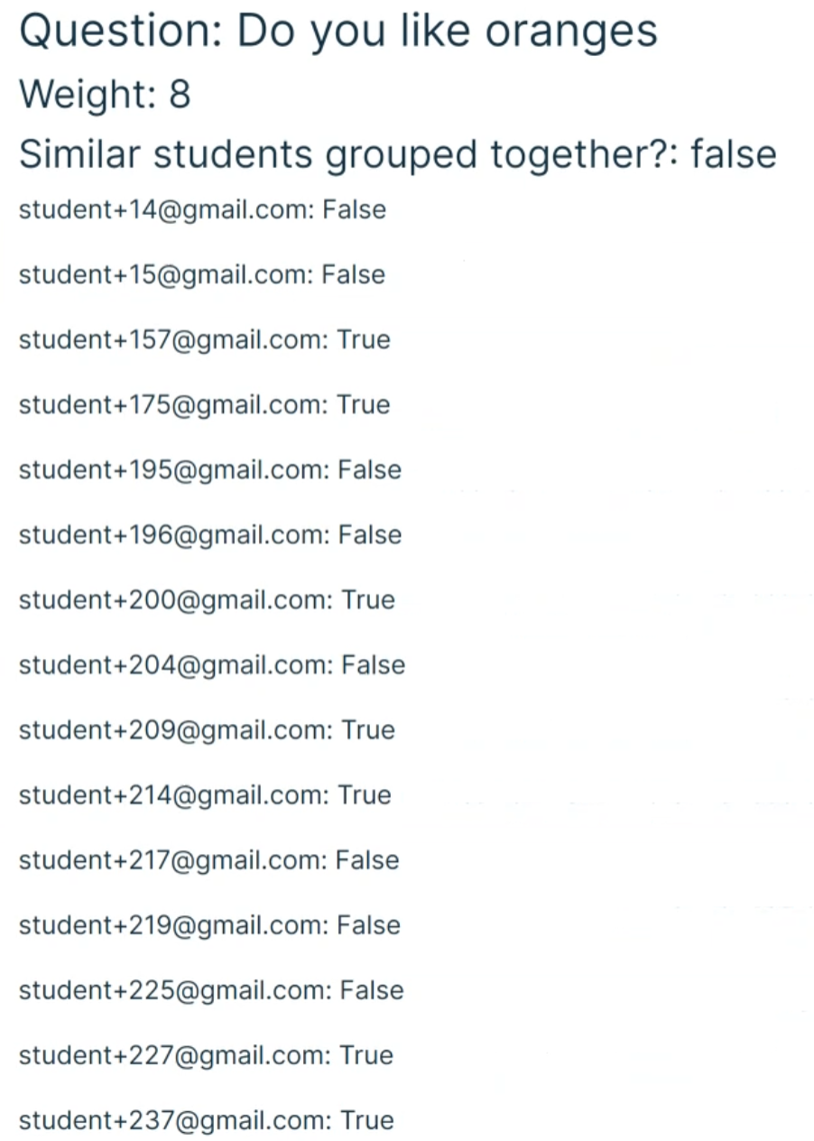
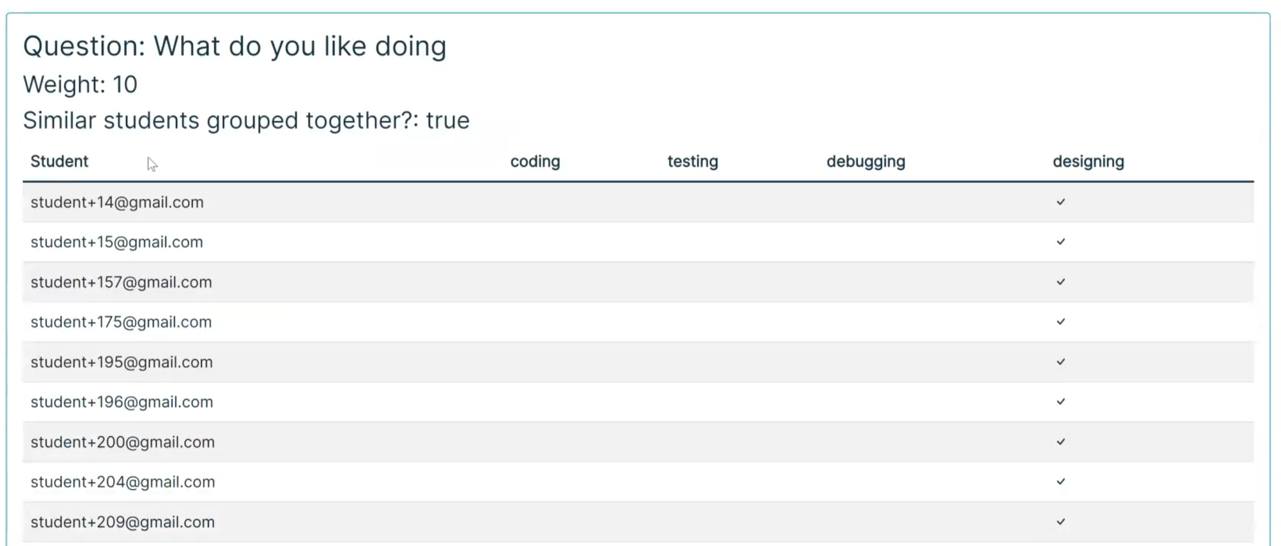
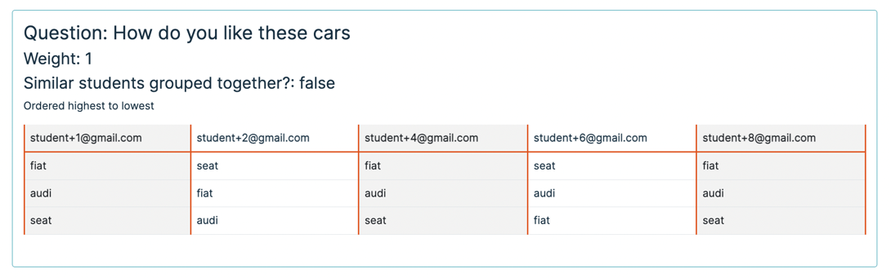
Results

Slide 24
How my group communicated and did it work well or not?
Muneer Fakih

Slide 25
Contact methods
After being allocated groups, whatsapp group created
Easiest method of contact, arranged 1st meetup through there
Also used group to update eachother on what needs to be done/ what has been done
Teams

Slide 26
Meetings
Attended organised group meetups every Wednesday (labs)
Agreed on Friday as other meetup day
Best suited majority
2hr slot
Went over; what each of us were doing, helped eachother, worked on tasks collaboratively and individually, planned next steps

Slide 27
Scrum master
Took in turns to be scrum master
Scrum master = ensures group follows scrum framework- encourages team work rather than overseer
- responsible for Backlogs, updating screenshots of issues board, called for sprint standups etc

Slide 28
Pros of our communication methods
Stayed in touch regularly
Help/access was always available for each other
Able to update each other on progress
Able to notify each other of issues arising regarding attendance/programming etc
Easy to plan ahead

Slide 29
Cons
People sometimes not responsive, can be difficult to get a hold of
Sometimes people not available so can’t get detailed update, only briefing

Slide 30
Plans to take this project forward
Aditya Shukla

Slide 31
Features we could potentially implement
Email to detail recommended methods for students to collaborate during module
Integrated assignment submission system
Ability for students and convenors to add reviews about efficiency of system
Ability to report inactive group members to convenors

Slide 32
Why implement these features?
Benefits
Recommended methods for collaboration
Increased efficiency and quality for work output
Easier experience for students with recommended tools
Integrated assignment submission system
Improves user experience
Convenor and student review system
Allows developer to see pros and cons
Reporting system
Ease of access to contact convenor about issues

Slide 33
Potential implications to consider and viable solutions
Submission system might be faulty
More established systems such as “Turnitin” could be deployed instead
Students may encounter difficulty with recommendations
Several options should be provided
Reviews may not be taken seriously
Reviews will not be anonymous; students will be held accountable for reviews
Reports may be inaccurate
Reports must be investigated properly before action is taken

